Slide 1
Cosmological Tests using Redshift Space Clustering in BOSS DR11 (Y. -S. Song, C. G. Sabiu, T. Okumura, M. Oh, E. V. Linder) following Cosmological Constraints from the Anisotropic Clustering Analysis using BOSS DR9 (E. V. Linder, M. Oh, T. Okumura, C. G. Sabiu, Y.-S. Song)
CosKASI
(Cosmology group at Korea Astronomy and Space Science Institute)
Minji Oh

Slide 2
Contents
Motivation
Redshift Space Distortion(RSD)
Measurements
Distances & Cosmic growth rate with Simulation
Results
Combined, Northern and Southern maps of DR11
Testing Cosmology
Conclusion

Slide 3
Contents
Motivation
Redshift Space Distortion(RSD)
Measurements
Distances & Cosmic growth rate with Simulation
Results
Combined, Northern and Southern maps of DR11
Testing Cosmology
Conclusion

Slide 4
Motivation
As known, the Universe is undergoing the accelerated expansion.
To understand the nature of Cosmic Acceleration(CA), which is caused by, so-called, ‘Dark energy’, several models such as cosmological constant, dynamic scalar field, and modified gravity, etc. were suggested.
Among these, finding out the best description for CA is one of the most challenging problems in cosmology.

Slide 5
Motivation
The expansion history and Large-scale structure formation of the Universe can be used for studying the characteristics of the dark energy.
Wide-deep redshift galaxy survey can provide information about the cosmic distances( DA, ) and growth rate ( , ) through which the expansion and structure growth rate of the Universe can be explored.

Slide 6
Contents
Motivation
Redshift Space Distortion(RSD)
Measurements
Distances & Cosmic growth rate with Simulation
Results
Combined, Northern and Southern maps of DR11
Testing Cosmology
Conclusion

Slide 7
Redshift Space Distortion(RSD)
: Anisotropic features in the clustering pattern of galaxies in redshift space
Main features
At linear regimes,
Kaiser effect- squeezed clustering pattern along line of sight
At non-linear regimes,
Finger of God effect- elongate clustering along line of sight
caused by the random virial motions of galaxies residing at halos

Slide 8
Redshift Space Distortion(RSD)
Improvement in
2D Power spectrum in redshift space
Kaiser(1987)
Scoccimarro(2004)
Taruya, Nishimichi, and Saito (Improved)(2010)

Slide 9
Redshift Space Distortion(RSD)
Decomposition
Song, Nishimichi, Taruya and Kayo(2013)

Slide 10
Redshift Space Distortion(RSD)
- Comparison with simulation
Song, Nishimichi, Taruya and Kayo(2013)

Slide 11
Redshift Space Distortion(RSD)
From to
in more explicit form

Slide 12
Redshift Space Distortion(RSD)
From to
By Fourier transformation
Song, Okumura and Taruya(2014)

Slide 13
Redshift Space Distortion(RSD)
Landy & Szalay (1993)
- Correlation function
Song, Okumura, and Taruya(2014)
The dotted: theory with simple Kaiser and Gaussian FoG effect
The solid: the improved/ blue filled contour: the observed using simulated map
Level: (0.2, 0.06, 0.016, 0.005, 0.002, -0.001, -0.006)

Slide 14
Contents
Motivation
Redshift Space Distortion(RSD)
Measurements
Distances & Cosmic growth rate with Simulation
Result
Combined, Northern and Southern maps of DR11
Testing Cosmology
Conclusion

Slide 15
Measurement: distances
Decrease DA by 10%
(Thin black solid to thin blue dashed)
Decrease H⁻¹ by 10%
(Thin black solid to thin blue dashed)
The BAO circle :
squeezed along the transverse direction
The BAO circle :
squeezed along the radial direction
Song, Okumura and Taruya et al.(2013)

Slide 16
Measurement: structure formation
Increase Gb by 10%
(Thin black solid to thin blue dashed)
Increase Gtheta by 10%
(Thin black solid to thin blue dashed)
- The BAO tip points move counter-clockwise
- 2D BAO circle: inv.
- The BAO tip points shrink toward the pivot point
- 2D BAO circle: inv.
Song, Okumura and Taruya et al.(2013)

Slide 17
Measurement: cut-off
σcut
Scut

Slide 18
Measurement: fitting method
After fixing the shape (scale-dependence) from the early universe information (Planck prior)
Fitting by rescaling the transverse and radial distances
The other fitting parameters: Gb, Gtheta, and σp (model-independent)
σp representing non-linear contamination to the power spectra of the density and velocity fields (FoG/ Gaussian)
↑The observed anisotropy Correlation Function
using ‘LCDM concordance model’
The theoretical C.F.↑

Slide 19
Contents
Motivation
Redshift Space Distortion(RSD)
Measurements
Distances & Cosmic growth rate with Simulation
Results
Combined, Northern and Southern map of DR11
Testing some Cosmology
Conclusion

Slide 20
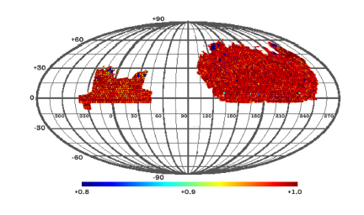
Data
11th Data Release(DR) of Baryon Oscillation Spectroscopic Survey (BOSS), a part of Sloan Digital Sky Survey (SDSS)
Especially on sample with Constant MASS (CMASS)
Covering the redshift range z = 0.43 ~ 0.7 (On average, z ~ 0.57) over ~8,500 square deg.
Containing 690,826 galaxies, 520,805 in Northern hemisphere and 170,021 in Southern hemisphere.
Coordinate transformation performed using the fiducial Planck best fit flat LCDM cosmological model.

Slide 21
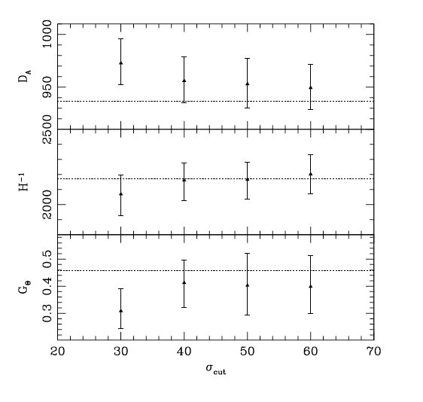
Result - applying on BOSS DR11 -
The thin black solid represents the best fit and the thin dashed ‘LCDM concordance’model
The contour level=(0.2, 0.06, 0.016, 0.005, 0.002, -0.001, -0.006) from the inner one

Slide 22
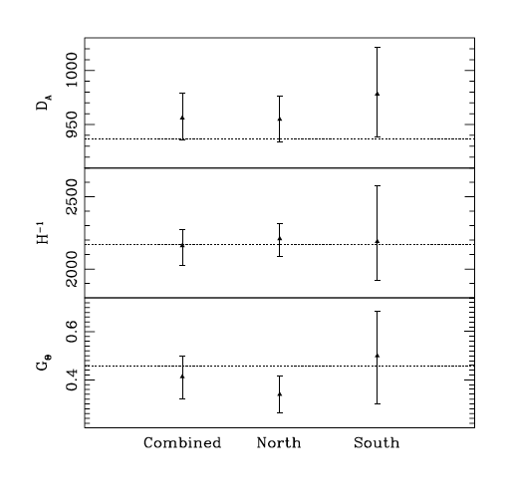
Result - applying on each hemisphere -

Slide 23
Contents
Motivation
Redshift Space Distortion(RSD)
Measurements
Distances & Cosmic growth rate with Simulation
Results
Combined, Northern and Southern maps of D11
Testing Cosmology
Conclusion

Slide 24
Testing Cosmology
Several consistency-check on
Friedmann-Robertson-Walker (FRW) cosmology using relation between DA and
General relativity and FRW using the relation between and

Slide 25
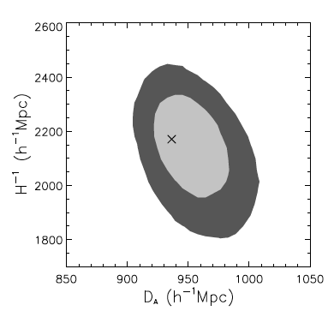
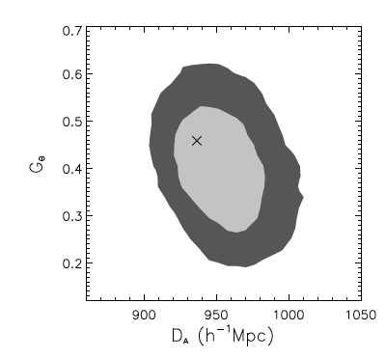
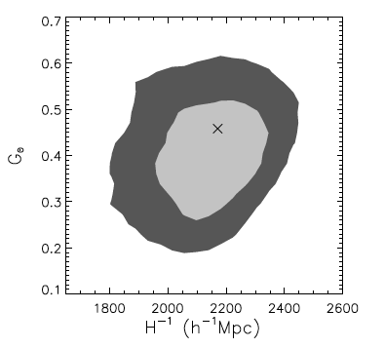
Testing Cosmology
“Planck early universe prior”
DA-Hinv plane
Gtheta-DA plane
Gtheta-Hinv plane
- Our model-independent analysis agrees within the 68% confidence level with the cosmology that assumed LCDM and GR

Slide 26
Contents
Motivation
Redshift Space Distortion(RSD)
Measurements
Distances & Cosmic growth rate with Simulation
Results
Combined, Northern and Southern maps of DR11
Testing Cosmology
Conclusion

Slide 27
Conclusion
Using BOSS DR11 CMASS sample with Planck CMB prior,
model-independent 2D redshift clustering analysis allow us to:
measure the angular diameter distance DA, Hubble scale Hinv, and growth rate Gtheta, which are consistent with Planck LCDM prediction
test several cutoff on the small scale and find that convergence is achieved for >40h/Mpc
find consistency with FRW and GR within 68% CL
compare the measurements from North and South sky samples and find consistency with Planck LCDM
σcut

Slide 28
Thank you :)

